Slide 1
Unit-1-2 Design Concepts: Use-Case Diagram & Class Diagram
KRISHNA BRAHMBHATT
Reference Book:
Software Engineering -A Practitioner’s Approach (Seventh Edition) - Roger S. Pressman.
Chapter 6: Requirement Modeling:Scenarios, Information and Analysis classes (6.2 and 6.5)

Slide 2
Use-Case Diagram
A use case diagram doesn't go into a lot of detail—for example modeling the order in which steps are performed.
Instead, a proper use case diagram depicts a high-level overview of the relationship between use cases, actors, and systems.
Experts recommend that use case diagrams be used to supplement a more descriptive textual use case.
Notation:
Use cases are represented with a labeled oval shape.
Stick figures represent actors in the process, and the actor's participation in the system is modeled with a line between the actor and use case.
To depict the system boundary, draw a box around the use case itself.

Slide 3
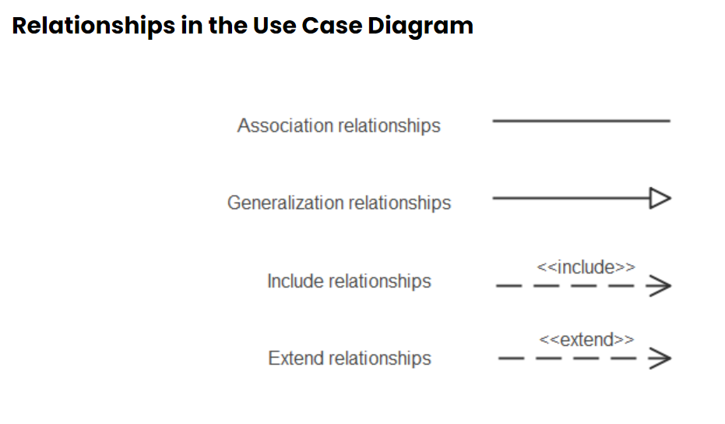

Slide 4
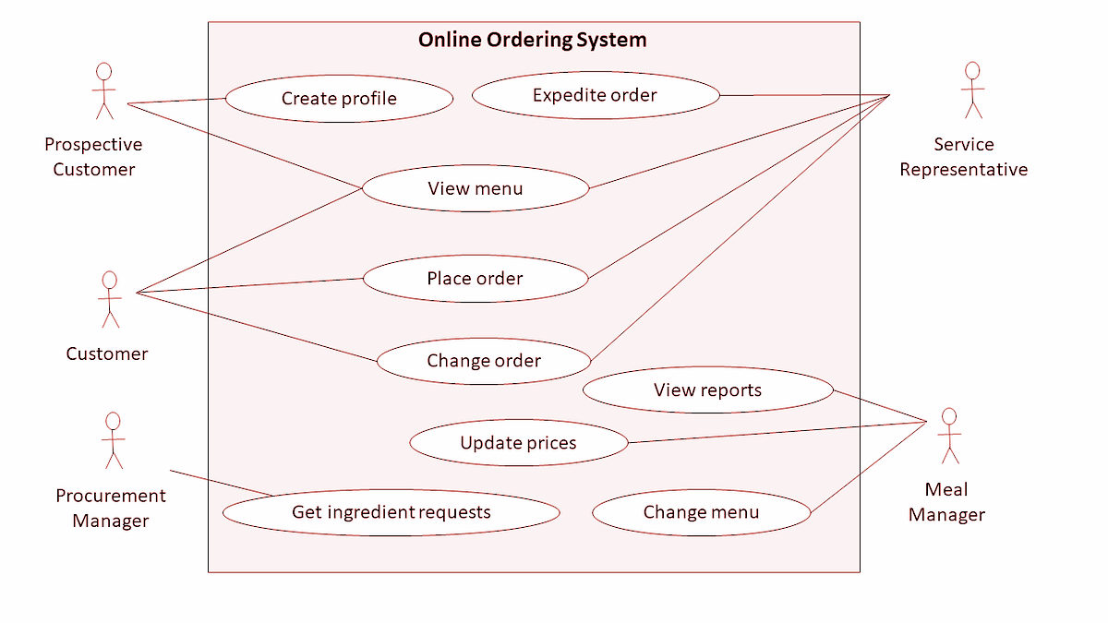

Slide 5
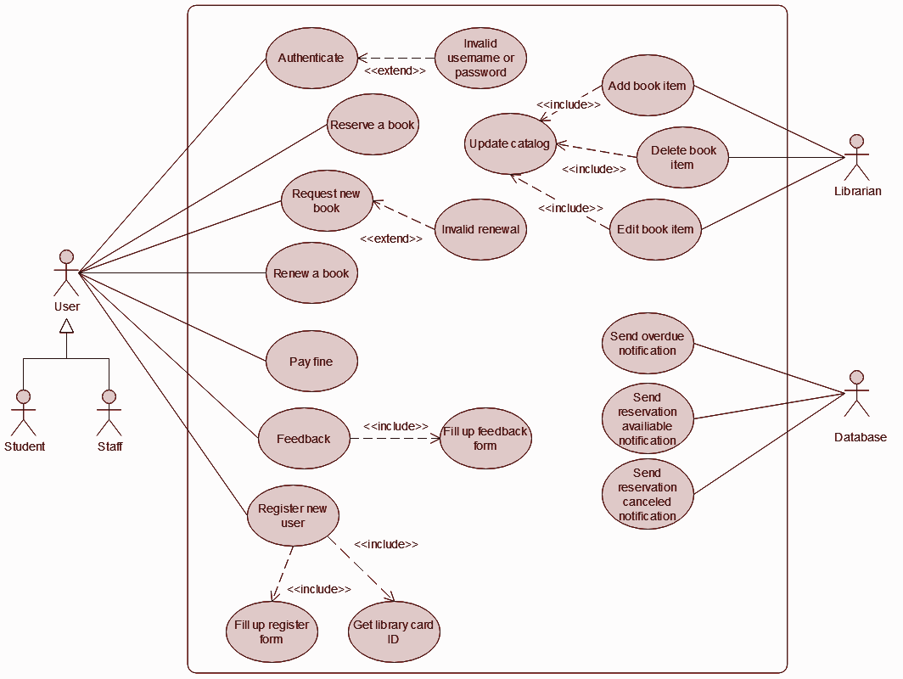

Slide 6
Class diagram
The purpose of class modeling is to describe objects in systems and different types of relationships between them.
The class diagram is used to construct and visualize object-oriented systems.
Class modeling is used to specify the structure of the objects, classes, or components that exist in the problem domain or system.
Class diagram provides a graphic notation for modeling classes and their relationships.
Class is a blueprint of an object.
An object is a concept, abstraction, or thing with an identity that has meaning for an application.
Class diagrams represent an overview of the system like classes, attributes, operations, and relationships.
In a given problem statement we should identify nouns that will build up classes.

Slide 7
Elements of Class Diagram (Class Name)
The name of the class appears in the upper section.
Class name should be meaningful.
Class name should always be aligned center of the upper section.
Class name should start with capital letters, and intermediate letter is a capital.
Class name should be always bold format.
For e.g.:
Abstract class name should be written in italic format.
Class Name
Attributes
Operations
Account
Customer
Employee

Slide 8
Elements of Class Diagram (Class Name) Cont.
For e.g. in the banking system, there are two types of accounts; one is a saving account and another is a current account.
Account is an abstract class and saving account and the current account is a subclass of Account.
The system can’t directly access the Account class. It is accessible by only saving accounts and current accounts.
Abstract class italic font
Account
Abstract class hence inherited
Normal class non italic font
SavingAccount
CurrentAccount

Slide 9
Elements of Class Diagram (Attributes)
An attribute is a named property of a class that describes a value held by each object of the class.
The UML notation lists attributes in the second compartment of the class box.
The attribute name should be in the regular face, left align in the box & use the lowercase letters for the first character.
The data type for the attribute should be written after the colon.
Accessibility of attribute must be defined using a member access modifier.
Syntax : accessModifier attributeName:dataType=defaultValue
For e.g. in this example ‘–’ represents private access modifier
Class Name
Attributes
Operations
Account
Customer
Employee
- accountNumber:long
- customerName:String
- employeeName:String

Slide 10
Elements of Class Diagram (Access Modifiers)
Public (+): Member accessible by all classes, whether these classes are in the same package or in another package.
Private (-): Member cannot be accessed outside the enclosing/declaring class.
Protected (#): Member can be accessed only by subclasses and within a class.
Package (~): Member can be accessible by all classes, within the package. Outside package member not accessible.
Static (underlined) : Member can be accessed using class name only.
In example you can see how to use access specifier
SavingAccount
+ accountNumber:long
+ name:String
# dob: Date
~ panNumber:String
ifsccode : String

Slide 11
Elements of Class Diagram (Operation)
The operation is a function or procedure that may be applied to objects in a class.
The UML notation is to list operations in the third compartment of the class box.
The operation name in the regular face, left align the name in the box, and use a lowercase letter for the first character.
Optional detail, such as an argument list and result type, may follow each operation name.
The return type of method should be written after colon.
Accessibility of operation must be defined using a member access modifier.
Syntax : accessModifier methodName(argumentList):returnType
Class Name
Attributes
Operations
For e.g.: you can see change phone number is a method that accepts phone number as an argument and return the int value as a response.
Account
+ changePhoneNumber(phoneNumber:String):int

Slide 12
Generalization & Specialization
Generalization is the process of extracting shared characteristics from two or more classes and combining them into a generalized superclass
Shared characteristics can be attributes or methods.
Represents an "is-a" relationship
For example, a car is a vehicle, and a truck is a vehicle. In this case, vehicle is the general thing, whereas car and truck are the more specific things.
Specialization is the reverse process of Generalization means creating new sub-classes from an existing class.
Vehicle
+ no of wheels:int
+start() : void
+stop() : void
+applyBreak() : void
+refilllFule() : int
Specialization
Generalization
Car
Truck
+parkAtHome() : void
+ loadGoods() : void
+ unloadGoods() : void

Slide 13
Generalization & Specialization
For example, in a bank, any Customer opens an account.
The account can be either a savings account or a current account. In saving account, customer earns fixed interest on the deposit. But this facility is not available in the current account.
Account
+ accountNo:long
+ balance:double
+debitAmount(amount:double): void
+creditAmount(amount:double) : int
+getBalance(accountNo:long) : double
SavingAccount
CurrentAccount
+ interestRate:double
+ isTransactionLimitOut(accountNo:long) : int

Slide 14
Link and Association Concepts
Link and associations are the means for establishing relationships among objects and classes.
A link is a physical or conceptual connection among objects.
An association is a description of a group of links with common structure and common semantic & it is optional.
Aggregation and Composition are the two forms of association. It is a subset of association.
Means they are specific cases of association.
In both aggregation and composition object of one class "owns" object of another class, but there is a minor difference.

Slide 15
Aggregation
Aggregation is a subset of association. it is a collection of different things.
It is more specific than an association.
It represents ‘has a’ relationship.
Aggregation implies a relationship where the child is independent of its parent.
For e.g.: Here we are considering a car and a wheel example. A car cannot move without a wheel.
But the wheel can be independently used with the bike, scooter, cycle, or any other vehicle.
The wheel object can exist without the car object, which proves to be an aggregation relationship.
Car
Wheel

Slide 16
Composition
The composition is a part of the aggregation. It represents the dependency between a parent and its children, which means if the parent is discarded then its children will also be discarded.
It represents ‘part-of’ relationship.
In composition, both the entities are dependent on each other.
For e.g.: Person class with Brain class, Heart class, and Legs class.
If the person is destroyed, the brain, heart, and legs will also get destroyed.
Person
Brain
Heart
Legs

Slide 17
Multiplicity
Multiplicity is the specification of the number of instances of one class that may be related to the instance of another class.
Multiplicity constrains the number of a related object.
You can use multiple associations between objects.
Some typical type of multiplicity:
Multiplicity | Option | Cardinality
0..1 |  | No instances or one instance
1..1 | 1 | Exactly one instance
0..* | * | Zero or more instances
1..* |  | At least one instance
5..5 | 5 | Exactly 5 instances
m..n |  | At least m but no more than n instances

Slide 18
Example Of Multiplicity
One to One Association
Account Holder
has
Cheque Book
One account holder has one cheque book
1
1
Many to Zero or One Association
An account holder can issue at most one debit card.
Or
An account holder can ask for at most one debit card or none.
Account Holder
issue
Debit Card
*
0..1
Many to Many Association
Every account holder can withdraw money from all ATMs.
Or
All account holders can withdraw money from all ATMs.
Account Holder
withdraw
ATM
*
*
One to One or Many Association
Bank
have
Branch
The bank should have at least one branch.
1
1..*

Slide 19
Role Names or Association End Names
A role is one end of an association.
A binary association has 2 roles, each of which may have a role name.
A role name is a name that uniquely identifies one end of an association.
Roles often appear as nouns in problem descriptions.
Use of role name is optional.
Association end names are necessary for associations between two objects of the same class.

Slide 20
Role names for an association
employee
employer
person
company
Works-for
Employee Employer
Ram TCS
Mohan Wipro
A reference is an attribute in one object that refers to another object.
For example, a data structure for Person might contain an attribute employer that refers to a Company object, and a Company object might contain an attribute employees that refers to a set of Person objects.

Slide 21
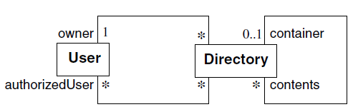
Advantages of Association End Names
Association end names are necessary for associations between two objects of the same class. They can also distinguish multiple associations between a pair of classes.
Container and contents distinguish the two usages of Directory in the self-association.
Each directory has exactly one user who is an owner and many users who are authorized to use the directory.

Slide 22
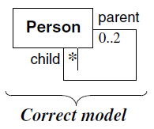
Advantages of Association End Names
One person instance participates in two or more links, twice as a parent and zero or more times as a child.

Slide 23
Qualification/Qualified Associations
A qualified association is an association in which an attribute called the qualifier disambiguates the objects for a “many” association end.
Qualification reduces the effective multiplicity of this association from one-to-many to one-to-one.
The notation for a qualifier is a small box on the end of the association line near the source class. The qualifier box may grow out of any side (top, bottom, left, right) of the source class. The source class plus the qualifier yields the target class.
A qualified association can also be considered a form of ternary association.

Slide 24
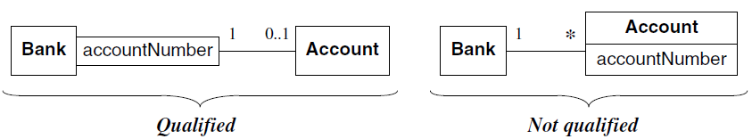
A bank services multiple accounts. An account belongs to a single bank.
Within the context of a bank, the account number specifies a unique account.
Bank and Account are classes and account Number is the qualifier.
Directory
File
File name
A directory plus a unique file name yields a file
A qualified association

Slide 25
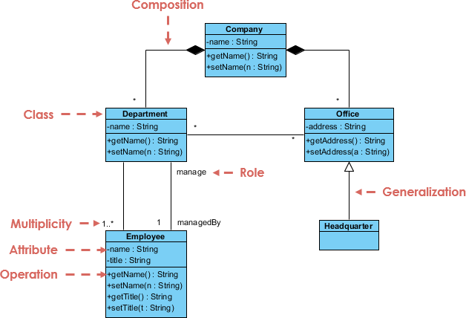
A company consists of departments. Departments are located in one or more offices. One office acts as a headquarter. Each department has a manager who is recruited from the set of employees. Your task is to model the system for the company.

Slide 26
Class Diagram Of Bank Management System
*
Bank
- name : string
- code: string
*
have
+manageBranch();
have
*
1..*
Account
ATM
Branch
- location : string
- manageBy: string
manage
- branchName : string
- branchCode: string
1
have
1..*
~ accountNumber: string
- balance: number
*
*
+transaction();
+ manageAccount():void
+ transaction():init
+debitAmount(amount:double): void
+creditAmount(amount:double) : int
+getBalance(accountNo:long) : double
*
1..2
*
transaction
manage
have
*
Customer
- name: string
- address: string
- dob: date
- panNumber: string
1
CurrentAccount
SavingAccount
*
- interestRate:double
+ isTransactionLimitOut(accountNo:long) : int
+ manageAccount():void
+ transaction():init

Slide 27
Class Diagram Of Library Management System
Librarian
1
manage
Member
- name:string
- contactNo: number
workFor
*
~ mName: string
- mContact: number
- mType: string
- mNoOfBookIssued: int
1
membership
+ addLibrarian():void
+ updateInfo():int
+ removeLibrarian(id:int):int
+ login(uname:string,pass:string):int
1
*
*
Library
- id:int
- name:string
+ addMember():void
+ udateMember():int
+ issueBook(bookID:int):void
+ returnBook(bookID:int):void
+ registration():void
+ authentication(mID:int):int
1
request
1
1
Book
have
1…*
- authorName:string
- publisherName:String
manage
Material
- materialID:int
0…3
*
+ addMaterial():void
+ updateMaterial():int
+ removeMaterial(bookID:int):int
+ issueMaterial(bookID:int):void
+ returnMaterial(bookID:int):void
QestionPaper
- subject:string
- examName:String
Staff
Student
- name:string
- enrNo:int
- name:string
CD/DVD
+ payFine():int
- type:string
- topic:String

Slide 28
Question : Draw Class Diagram for the given Problem
An bank institution may issue at most a single credit card accounts, each identified by an account number.
Each account has a maximum credit limit, a current balance, and a mailing address.
The account serves one or more customers who reside at the mailing address.
The institution periodically issues a statement for each credit-account.
The statement lists a payment due date, finance charge, and minimum payment.
The statement itemizes various transactions that have occurred throughout the billing interval: cash advances, interest charges, purchases, fees, and adjustments to the account.
The name of the merchant is printed for each purchase.

Slide 29
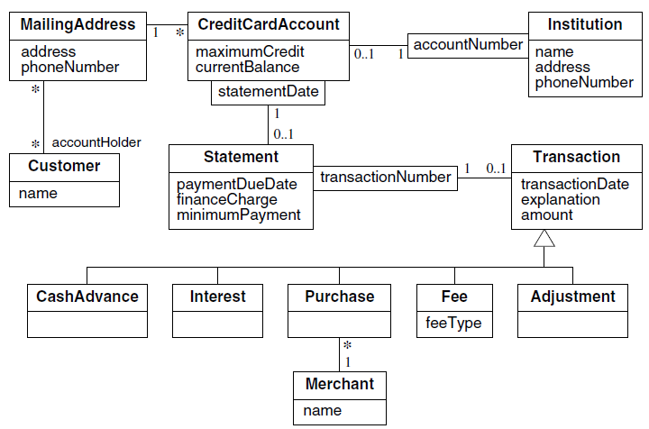
The name of the merchant is printed for each purchase.

